Slide 1
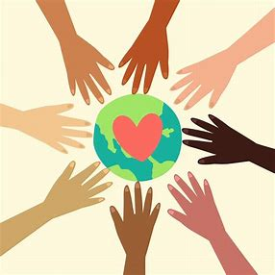
SDGs Racism
Teaching Materials
Io, Tomoya, Rimi, Maori

Slide 2
<a>(00:00~00:18) Why is (①) important for the US right now and in the world?
(①) is our call to (②). It is a tool to reimagine a world where black people are free to exist, free to (③). It is a tool for our allies to show up differently for us.
<b>(3:29~3:44)So I think race and (④) is probably the most studied social, economic and political (⑤) in this country, but it's also the least understood. The reality is that race in the United States operates on a (⑥) from black to white. Doesn't mean that people who are in between don't experience (④), but it means that the closer you are to white on that (⑥), the better off you are. And the closer to black that you are on that (⑥) the worse off you are.
<c> (10:44~11:29)So you all are doing work that forces you to face some (⑦), painful realities on a daily basis. What gives you hope and (⑧)you in that context?
I am hopeful for black futures. And I say that because we live in a society that's so (⑨) with black death. We have (⑩) of our death on the TV screen, on our Twitter timelines, on our Facebook timelines, but what if (⑪) we imagine black life? We imagine black people living and (⑫) . And that -- that (⑧) me.
<Listening Question Sheet>
You are going to listen to part of the interview about racial disclimination, listen carefully to the audio and answer some questions.
1⃣.A Listen to the audio and fill in the blank below sentences.(5 mins)
https://www.ted.com/talks/alicia_garza_patrisse_cullors_and_opal_tometi_an_interview_with_the_founders_of_black_lives_matter/transcript?language=ja

Slide 3
C.(13:58~14:46)In this interview, there are two things these people ask the audience to do, write down under the blank to make sentence correct (15 mins)
ex)Interviewer
First step
Having our minds open and shift
↓
Take action
Call the 1………….... and 2…………. that they stop doing something that harms black people
↓
Get involved
3……… something, 4 .... … ….. of something
B.Read the statements and markTrue or False on the answer sheet. (7 mins)
(1) There is a campaign that black can be treated equally.
(2) Racial issues are socio-economically and politically studied and well understood by the country.
(3) If you are black people and close to white, you will not discriminate.
(4) The woman believes that there is no hope for the future of black people unless the image of black death is completely erased from social media and television.

Slide 4
2⃣. This is a project to have a restaurant demonstrate an actual case of discrimination and see the reaction of other customers. Write down what you felt assuming you were there. After that, discuss it in your group.(0:00~ 3:28)What Would You Do: Customers discriminate against Latino waiter | WWYDWhat Would You Do: Customers discriminate against Latino waiter | WWYD
Name | Student ID
① | ② | ③ | ④
⑤ | ⑥ | ⑦ | ⑧
⑨ | ⑩ | ⑪ | ⑫
<Answer Sheet>
Q1
Q2
Q3
Q4
(1)
(2)
(3)
(4)
1 | 2 | 3 | 4

Slide 5
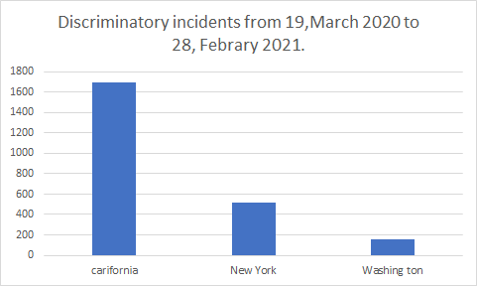
Q１，Choose the number that fits in each parenthesis.
Late last year, the United Nations issued a report that detailed "an alarming level" of racially motivated violence and other hate incidents against Asian Americans.
It is difficult to determine exact numbers for such crimes and instances of discrimination, as no organisations or governmental agencies have been tracking the issue long-term, and reporting standards can vary region to region.
The advocacy group Stop AAPI Hate said it received more than（ a ）reports of hate incidents directed at Asian Americans and Pacific Islanders nationwide last year.
a, A 2800, B 6880, C,10790, D, 1200
You can refer to the information below.
Q２、・What kind of discrimination have been reported ??
Choose the sentence that corresponds to each number
a, Workplace discrimination or refusal of service
b, Verbal harassment
c, Coughed/ Spat on
d, Shunning
e, Physical assault

Slide 6
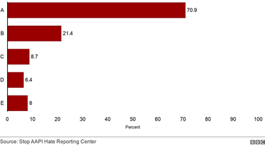
Q,3 For the underlined part, use your imagination to think about what this sentence means.
Although the Asian population grew faster than other major groups in the last US census, the community's stories are not widely covered in the media and its concerns are not polled by political parties, Ms Nguyen told the BBC.
Some federal agencies do not even include the Asian American and Pacific Islander community in their definitions of racial minorities, she notes.
Ms Nguyen says that the people attacking Asian Americans since the pandemic began "can't really differentiate and don't care if we are X, Y or Z".
"They have made us a scapegoat to enact their violence."
For Ms Nguyen, the more visibility anti-Asian crimes receive, the better. She notes that laws can help solve the problem, but the US needs a cultural shift as well.
"We are in a moment of reckoning right now," Ms Nguyen adds. "We have been systematically erased on every single level and people can start to combat that by educating themselves about us."
Q,4 Why do people discriminate, not just against Asians? How can we reduce discrimination? Give your own opinion. (10 minutes)
Answer sheet

Slide 7
A | B | C | D | E
Q1, a, | Q2,
Q3 Q4.

Slide 8
Time limitation: 40 min
Read this passage and answer the following questions
Reducing inequalities and ensuring no one is left behind are integral to achieving the Sustainable Development Goals. Inequality within and among countries is a persistent cause for concern.
(5. ) some positive signs toward reducing inequality in some dimensions, such as reducing relative income (6. ) in some countries and preferential trade status benefiting lower-income countries, inequality still persists.
COVID-19 has deepened existing inequalities, hitting the poorest and most vulnerable communities the hardest. It has put a spotlight on economic inequalities and fragile social safety nets that leave vulnerable communities to bear the brunt of the crisis. At the same time, social, political and economic inequalities have amplified the impacts of the pandemic.
On the economic front, the COVID-19 pandemic has significantly increased global unemployment and dramatically slashed workers’ incomes.
COVID-19 also puts at risk the limited progress that has been made on gender equality and women’s rights over the past decades. Across every sphere, from health to the economy, security to social protection, the impacts of COVID-19 are (7. ) for women and girls simply by virtue of their sex.
Inequalities are also deepening for vulnerable populations in countries with weaker health systems and those facing existing humanitarian crises. Refugees and migrants, as well as indigenous peoples, older persons, people with disabilities and children are particularly at risk of being left behind. And hate speech targeting vulnerable groups is rising.

Slide 9
Do the following statements agree with the information given in reading passage 1?
True: if the statement agrees with the information
False: if the statement contradicts the information
Covid-19 significantly influences disparities worldwide.
People who are struggling with discrimination are only immigrants.
We are on the verge of dealing with economic disparities, leading to being at risk of human rights.
Increasing unemployment is not related to infectious viruses.

Slide 10
B. Choose the best words to complete the sentence in the passage.
6. Despite, In addition, Furthermore, In spite of
7. discriminaiton, inequality, tax, statement
8. influenced, eradicated, excavated, exacerbated
C. Write how Covid-19 influences inequality, after reading the passage.

Slide 11
This passage describes how a multicultural company called “accenture” makes an effort to protect human rights.
HUMAN RIGHTS
H. As we serve clients across the globe, we support and respect internationally recognized human rights wherever we do business. These standards are expressed in the International Bill of Human Rights and the International Labor Organization’s Declaration on Fundamental Principles and Rights at Work. Support and respect for the protection of human rights are at the heart of our core values, especially Respect for the Individual, Best People and Integrity. Our commitment is anchored in our COBE, our Supplier Standards of Conduct and our global policies. We speak up if we experience any human rights violations and take action—or reach out for guidance—if we witness or become aware of any violations across the following areas:
I. • Diversity and equal opportunity—We are committed to eliminating discrimination in employment and apply our principle of meritocracy when we make decisions about our people. We value diversity and do not discriminate. We value different cultures, strive to have a diverse and inclusive workforce, and meet legal hiring mandates. (See Our People.)
J. • Employment conditions and working practices—We are committed to: - Eliminating human traficking, slavery, servitude and forced or compulsory labor. - Abolishing child labor. - Ensuring a respectful environment for our people. - Respecting the right of our people to form and freely join (or refrain from joining) legally constituted representative bodies and working in good faith with them.
K.• Health, safety and security—We are committed to ensuring the well-being of our people. (See Our People.) • Supply chain—We are committed to supporting and respecting human rights in our supply chain in a manner consistent with our Supplier Standards of Conduct. (See Supply Chain.)

Slide 12
Write the correct letter, H-K, in boxes
12. Mention of the importance of human right in the workplace
13. Mention of the importance of understanding different cultures
14. Examples of harsh working environment and mation of the importance of creating the new environment where employees can feel comfortable to work
15. Three keys to protect human right
Choose the letter and Fill in the blank to complete the sentence.
It is of paramount importance that (16. ) and ( 17. ) play an essential role in protecting ( 18. ). In business, when the company makes a decision about new unemployment, ( 19. ) and ( 20. ) contribute to eliminating racial dicrimination.
For the purpose of eradicating inequality, improving ( 21. ) and ( 22. ) can prevent an exacerbating working environment for employees.

Slide 13
This passage explains the solution for racial discrimiaiton, related to SDGs 10. Read this passage and answer the following questions.
What can we do? Reducing inequality requires transformative change. Greater efforts are needed to eradicate extreme poverty and hunger, and invest more in health, education, social protection and decent jobs especially for young people, migrants and other vulnerable communities. Within countries, it is important to empower and promote inclusive social and economic growth. We can ensure equal opportunity and reduce inequalities of income if we eliminate discriminatory laws, policies and practices. Among countries, we need to ensure that developing countries are better represented in decision-making on global issues so that solutions can be more effective, credible and accountable. Governments and other stakeholders can also promote safe, regular and responsible migration, including through planned and well-managed policies, for the millions of people who have left their homes seeking better lives due to war, discrimination, poverty, lack of opportunity and other drivers of migration.

Slide 14
Choose Three of the correct statements based on the passage above.
22, 23, 24
L: Tackling racial discrimination need to implement alternative changes and solutions.
M: Only developing countries are on the brink of dealing with racial discrimination.
N: Few people who are struggling with injustice.
O: International cooperation plays an essential role in eradicating bias and poverty.
P: The government and stakeholders fail to take into account creating new policies for the solution.
Q: We should never remove discriminatory laws and other policies.
R: The government is a key contributor to improving the education system and social security for susceptible people.

Slide 15
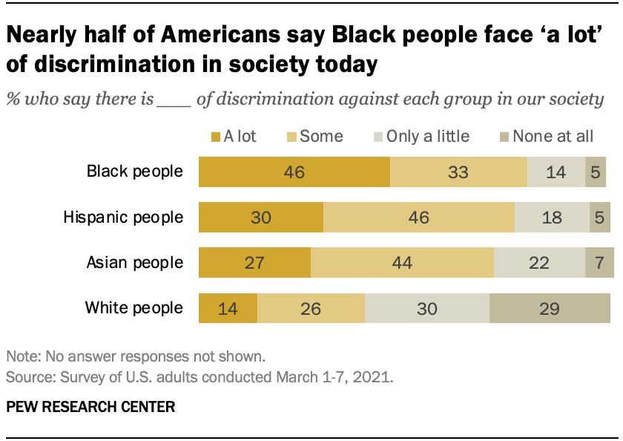
C. Look at this graph. This graph illustrates the situation of racial discrimination in America. Describe the graph and write your opinion about the solution to racial discrimination.
United Nations. (2018). Reduce inequality within and among countries - united nations sustainable development. United Nations Sustainable Development. https://www.un.org/sustainabledevelopment/inequality/
United Nations. (2018). EQUALITY: WHY IT MATTERS. United Nations.
https://www.un.org/sustainabledevelopment/wp-content/uploads/2018/09/Goal-10.pdf
Accenture. (2017). CORPORATE CITIZENSHIP REPORT 2017. Accenture.
https://www.accenture.com/_acnmedia/PDF-75/Accenture-2017-Corporate-Citizenship-Report.pdf#zoom=50

Slide 16
Answer sheet
1 | 2 | 3 | 4
5 | 6 | 7
 | The impact of Covid-19
8
9
10
11 | 12 | 13 | 14
15 | 16 | 17 | 18
19 | 20 | 21 | 22
23 | 24
25

