Slide 1
Teachers material
(Flow)
1. Play the audio (listening sheet).
2. Let the students work on listening worksheet for 10~15 minutes.
3. Give answers for listening worksheet.
4. Work on reading material for 40 minutes.
5. Give answers for reading worksheet.
6. Discussion: Make groups of three or four and discuss about their opinions about SDGs (About 15 minutes).

Slide 2

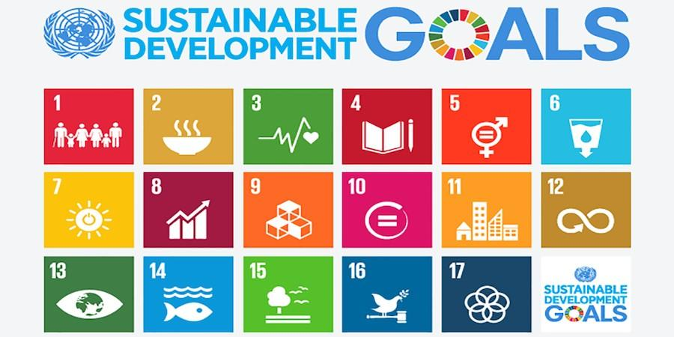
Listening materials
Watch two videos and choose the SDGs Goal that match the symbols below
Do you know all 17 SDGs?
https://youtu.be/qfOgdj4Okdw (~3:40)
20 min
The goals
Good Health
and Well Being
Decent Work and
Economic Growth
Sustainable Cites
and Communities
Industry, Innovation
and Infrastructure
Climate Action
No Poverty
Clean Water
and Sanitation
Affordable and
Clean Energy
Reduce
Inequalities
Life
Below Water
Life on Land
Partnerships
For The Goals
Peace, Justice
and Strong Institution
Responsible
Consumption
and Production
Quality Education
Zero Hunger

Slide 3
Answers for listening
No Poverty
Zero Hunger
Good Health and Well Being
Quality Education
Gender Equality
Clean Water and Sanitation
Affordable and Clean Energy
Decent Work and Economic Growth
Industry, Innovation and Infrastructure
Reduce Inequalities
Sustainable Cities and Communities
Responsible Consumption and Production
Climate Action
Life Below Water
Life on Land
Peace, Justice and Strong Instituition
Partnerships For the Goals

Slide 4
Reading material
Read this article and answer the questions.
10 min
1. The Sustainable Development Goals (SDGs) is the set of 17 global goals provided by the UN to unite global stakeholders in the work towards a better and more sustainable future for everyone. The SDGs provide a historic opportunity for international partnership in order to address the global challenges the world faces, such as extreme poverty, environment degradation, injustice, and discrimination. Sustainable Development is most often defined as “meeting the needs of the present without compromising the ability of future generations to meet their own needs.” The 17 global goals are structured into 169 ambitious targets, with the goal to achieve them by 2030. As for businesses, the targets can help clarify which key SDG challenges your business will prioritize.
2. The story about the SDGs began even before their inception in 2015. In September 2000, The United Nations Procurement Division (UNDP) gathered leaders of 189 countries and signed the historic Millenium Development Goals (MDGs), a declaration which committed a collaboration between nations to achieve a framework of eight goals. The goals ranged from halving extreme poverty and hunger to promoting gender equality by 2015.Unfortunately, the goals were not fully met by 2015, but the project became the most successful anti-poverty moment in history and the start of a common language to reach global sustainability. The SDGs originated from the UNDP and the same allied countries, with the goal to continue working towards the efforts outlined in the MDGs. But this time around, the whole spectrum of sustainability would be considered – encompassing people, planet and profit.

Slide 5
Since Agenda 2030 was authorized, it has provided as a framework for organisations, institutions, and governance to work towards a more sustainable world. Today, 2030 is less than a decade away and we are still facing numerous challenges and difficulties to overcome. Being a part of and contributing towards the SDGs is not only critical to change our trajectory towards a sustainable future, but is also profitable for business’ short and long term success.
3. We all have a part to play in reaching the goals by 2030. To best connect and engage with the framework, make sure to educate yourself and your business to understand what responsibility you hold and what opportunities your organization gains by contributing. By anchoring the SDGs within your business, you will not only contribute to the critical change, but also stay on the cutting edge of your industry and thus grow your business, building trust with customers and stakeholders alike. So, be a part of the change that benefits both the planet and your business!

Slide 6
Complete the following text after reading and fill the words from the box.
Name: _________________________
10 min
challenges 169 17 196 71 extreme poverty 2030 2040 environment degradation discrimination
poverty 8 2015 sustainability UNDP
SDGs are the 1____global goals to protect our sustainable future. Our world is facing huge issues such as 2_____________, 3_____________, injustice, and 4____________. There are 5____ targets to achieve by 6____. In terms of businesses, targets can help clarify the main 7________ of the SDGs that your business will prioritize.
The story of the SDGs began before 1______. In September 2000, 2______ brought together leaders from 189 countries and signed the MDGs with 3______ framework goals. Goals ranged from halving extreme poverty, hunger, and gender equality. Unfortunately, the goal was not fully achieved by 2015, but the project became the most successful 4______ alleviation in history and the beginning to reach global 5______.

Slide 7
Answers for reading
1. SDGs are the 17 global goals to protect our sustainable future. Our world is facing huge issues such as extreme povert, environment degradation, injustice, and discrimination.There are 169 targets to achieve by 2030. In terms of businesses, targets can help clarify the main challenges of the SDGs that your business will prioritize.
2. The story of the SDGs began before 2015. In September 2000, UNDP brought together leaders from 189 countries and signed the MDGs with MDGs framework goals. Goals ranged from halving extreme poverty, hunger, and gender equality. Unfortunately, the goal was not fully achieved by 2015, but the project became the most successful sustainability alleviation in history and the beginning to reach global poverty.

Slide 8
Additional Exercise
(Reading worksheet)
Name: _________________________
15 min
Read the statement. Write T (true) or F (false).
1 We all have a part to play in reaching the goals by 2030.
2 The SDGs do not include economic sustainability.
3 By anchoring the SDGs within your business, you will not only contribute to the critical change, but also stay on the cutting edge of your industry.
4 You don't need to understand what you are responsible for in order to achieve your goals, as long as you understand the current situation.

Slide 9
Discussion Worksheet
Name: ________________
15min
1. Write down any of your opinions and ideas through SDGs.
2. Share your opinions with your group members and write down your friends ideas.
3. What can you do from now on to sustain our future globe?
Discuss with your group members.

Slide 10
Transcription of listening material
Hi folks, Alex here. In 2015, the United Nations set up 17 sustainable development goals (also known as SDGs) that were adopted by 193 countries and our mission is to achieve these goals by 2030.
In this video we are going to talk about the SDG wedding cake and two other interesting ways you can use these goals to see if your country or your business is sustainable. Ok, let’s get drawing!
On this channel, we share tools to help YOU change the world so subscribe if that’s of interest to you. To be totally honest, the problem with these 17 goals is that… well, there are 17 of them… which can make them look complicated and not easy to remember. But the good thing about them, is that they are the result of many public consultations
and they provide a shared language for all countries to report on. They also cover a lot of important things and they can tell us if we are becoming sustainable. Or do they? First, let’s look at how they are interconnected instead of looking at them individually. The Stockholm Resilience Centre suggested organizing the SDGs into 3 layers: the environment as the foundation, supporting society which supports the economy.

Slide 11
This is like the triple bottom line (or the 3 pillars of sustainability) I presented in another video (I put the link in the description below). Essentially, sustainability is about meeting human needs within ecological constraints, and the economy is a strategy to make money while achieving sustainability.
There are 4 goals about the environment: life below water, climate action, life on land and life below water. 8 goals are about society: No Poverty, Zero Hunger, Good Health and Well-being, Quality Education, Gender Equality, Affordable and Clean Energy, sustainable cities & communities and peace, justice and strong institutions. And these 4 goals are about the economy: Decent Work and Economic Growth, Industry, Innovation, and Infrastructure, Reduced Inequalities, Responsible Consumption and Production. They called this representation the SDG wedding cake. In other words, we can’t achieve “decent economic growth” or even food security without first taking care of our oceans as was demonstrated in Newfoundland during the collapse of the Atlantic cod fishery in the 1990s. And, to use the more recent example of the coronavirus crisis, we can’t have everybody in “good health” and achieve “no poverty” without taking care first of our land, forests and our greenhouse gas emissions. My video on coronavirus explains this in more details.
With the 17 goals, come targets and indicators. I am not going to bore you with all the 169 targets and 232 indicators but if we look at the “affordable and clean energy” goal as an example, it has 5 associated targets which read like this: By 2030, ensure universal access to affordable, reliable and modern energy services; By 2030, increase substantially the share of renewable energy in the global energy mix; By 2030, double the global rate of improvement in energy efficiency, etc.

Slide 12
Additional Exercise
(Reading worksheet) (Answer)
Name: _________________________
15 min
Read the statement. Write T (true) or F (false).
1 We all have a part to play in reaching the goals by 2030.
T
2 The SDGs do not include economic sustainability.
F
3 By anchoring the SDGs within your business, you will not only contribute to the critical change, but also stay on the cutting edge of your industry.
T
4 You don't need to understand what you are responsible for in order to achieve your goals, as long as you understand the current situation.
F

Slide 13
References
Reading material
A beginners guide to the sdgs. A Beginners Guide To The SDGs. (n.d.). Retrieved October 22, 2021, from https://content.worldfavor.com/en/a-beginners-guide-to-the-sdgs.
Listening materials
Sustainability Illustrated. Sustainable Development Goals explained with 3 useful tips. 2021, March 26. Retrieved October 22, 2021 from
https://sustainabilityillustrated.com/en/portfolio/3-interesting-ways-to-use-the-sustainable-development-goals/
United Nations. Do you know all 17 SDGs? 2018, April 20. Retrieved October 22, 2021 from
https://www.youtube.com/watch?v=0XTBYMfZyrM

