Slide 1
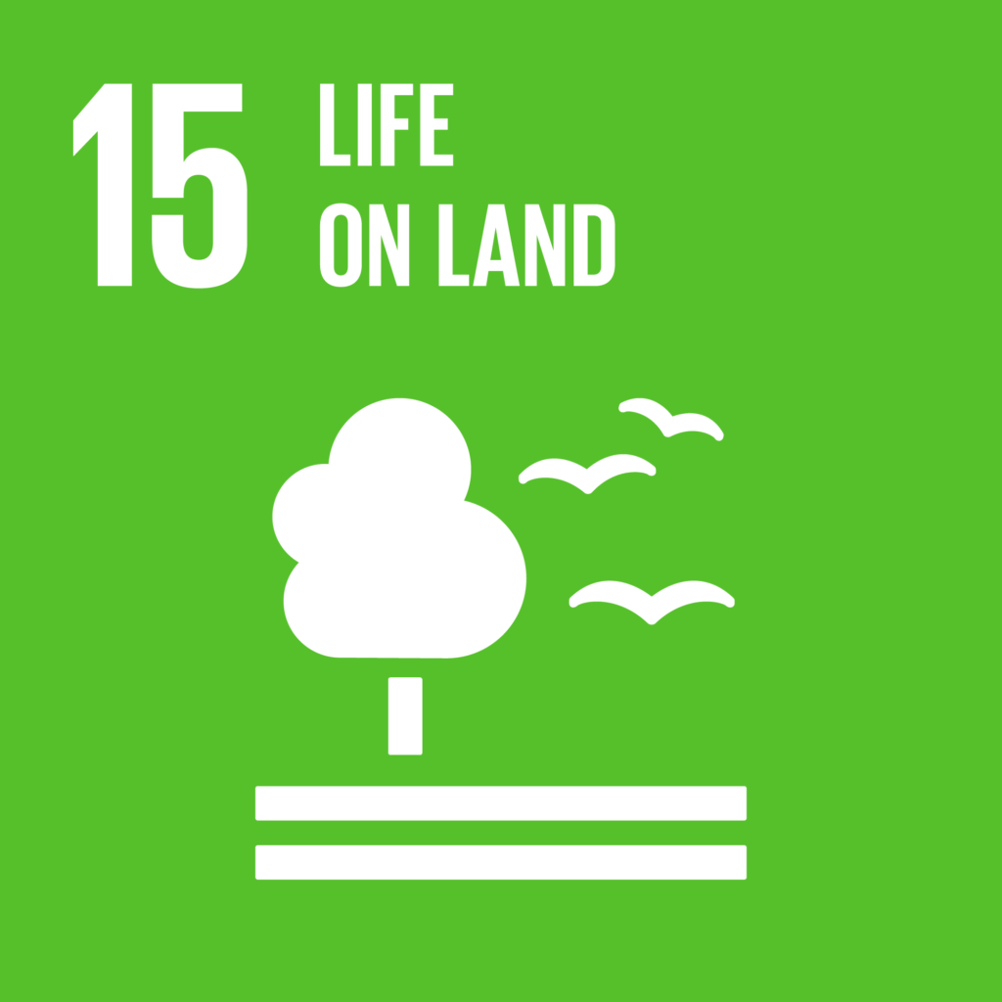
15. Life on Land
Iroha, Kana, Akari, Yukitaka, Kosuke, Yoshiki

Slide 2
What is Deforestation??
We will provide you the lecture about the deforestation related to SDGs 6. Let’s think about it deeply.

Slide 3
Deforestation is …
The removal of forests by people, which has been an increasingly serious problem worldwide, contributing to timber and soil scarcity as well as to global warming.
Theilmann, J. M. (2022). Deforestation. Salem Press Encyclopedia of Science.https://search.ebscohost.com/login.aspx?direct=true&db=ers&AN=89474630&lang=ja&site=eds-live.
What is Deforestation? | Eco Facts | One Tree Planted

Slide 4
Palm oil
The most widely consumed vegetable oil and fat in the world today.(31 percent of total production of vegetable oils)
Used cosmetic product, soap, food.
The use of food accounts for the 80 percent of the use of entire palm oil.
It is said that half of the supermarket items contain palm oil.

Slide 5
So much palm oil is being consumed in our daily lives!!!
toothpaste
facial cleaner
cosmetics
lunch
dinner
moisturizer
butter
margarin
cleaning detergent
laundry detergent
soap

Slide 6
Problems with palm oil
1. deforestation of southeast Asian rainforests
(it is proposed that the amount of palm oil production will be three times much between 2010 and 2030)
2. Terrible workforce environment
3. Some countries law do not require a breakdown of vegetables oils
4. Rob animals of food and habitat

Slide 7
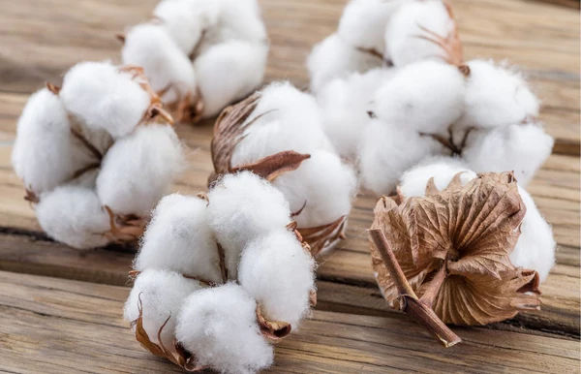
The disadvantages of Cotton
High amounts of water is need in the cotton production (cotton 1kg = 10,000L)
Large quantities of pesticides are used in cotton production

Slide 8
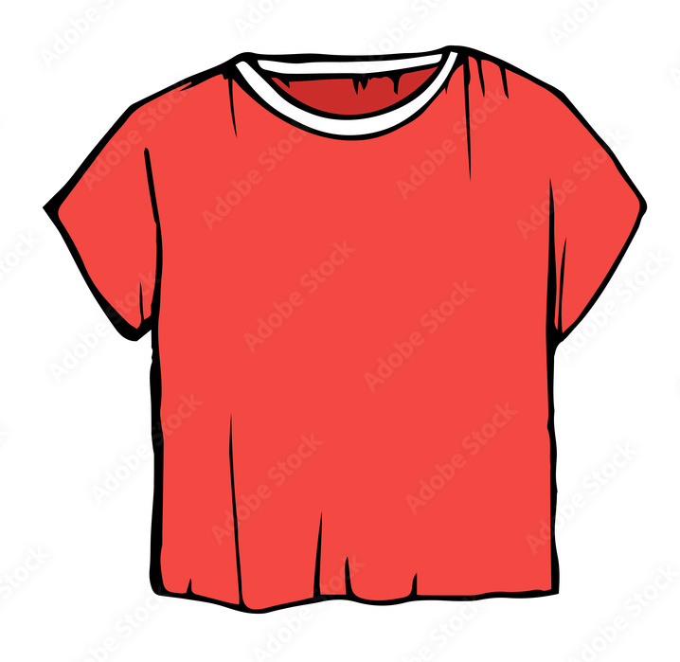
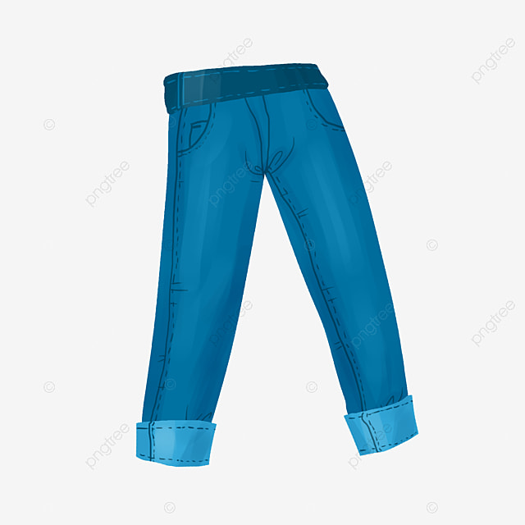
Problem 2: Cotton
Cotton is used in many things around us.
Ex) T-shirt, Dresses, Jeans, Towels
Cotton is an essential part of people's lives

Slide 9
Features and Advantages of Cotton Fabrics
High durability
Good breathability
Soft to the touch
Easy to dye
Static electricity resistance

Slide 10
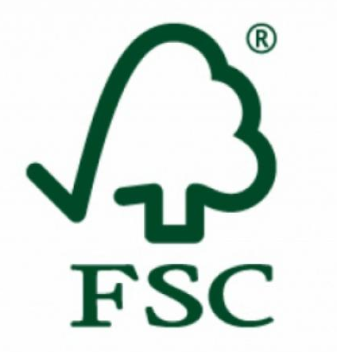
Activities by FSC
FSC(Forest Steward Council) was founded in 1994 to stop the deforestation.
It enable us to distinguish and purchase wood from properly managed forests.
FSC put FSC mark on environmentally-friendly products
⇒We can contribute to save the deforestation by choosing those products
FSC mark

Slide 11
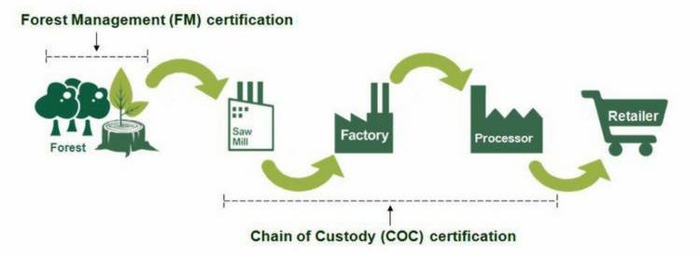
How FSC works?
FSC manages the commercial forests in an environmentally friendly way,processes them in certified industrial institutions, and then offers them to customers with the FSC mark.

Slide 12
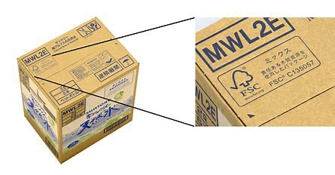
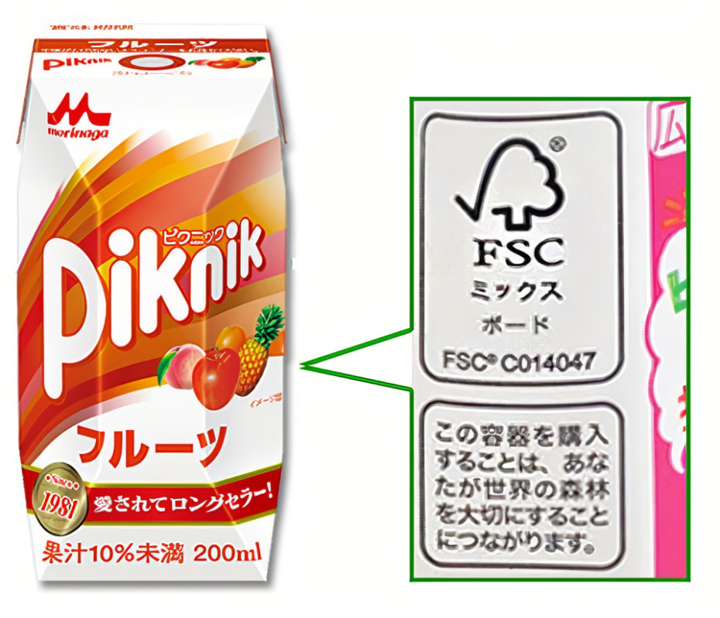
Buying these products helps to protect deforestation and animals!!

Slide 13
We also have some similar activities to protect deforestation by other institutions!!

Slide 14
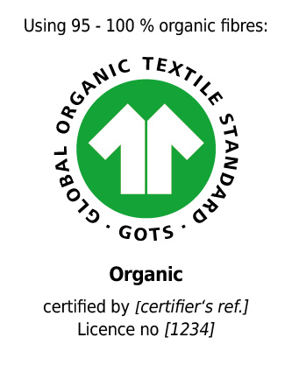
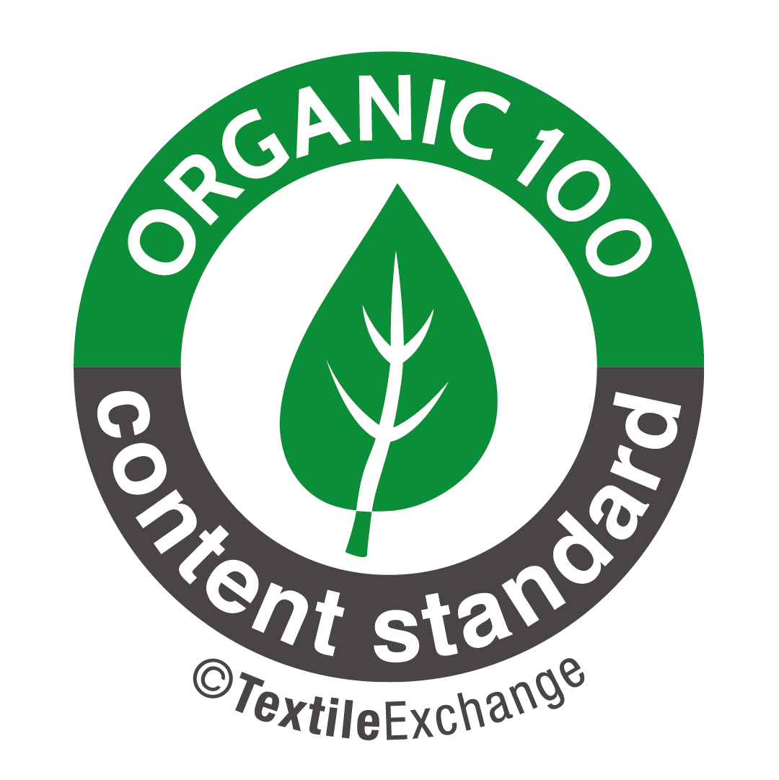
The left top mark is GOTS mark and the another one is OCS mark.
Both ensure the quality of cotton products.
However, GOTS mark also guarantee the contribution for environment
For example, it restricts the usage of chemical substances and water
In this section, scroll the under bar to above, then explanations are displayed
↓
Notes:
Gots mark, left one, is one of the certificates that ensure the quality of materials in several goods. The right one is OCS mark which also indicates the reliability of products. Both guarantee the cotton quality, however Gots mark also shows the protection of environment. For example, Gots mark restricts the usage of chemical substances to mitigate the burden on the environment in the production process.
Additionally, this mark also requires to restrain the amount of water consumption which is related to the water resources reservation.
On the other hand, the OCS mark doesn’t mention the usage of chemical substances nor water consumption.
Therefore, it’s preferable to buy products with the Gots mark in the perspective of eco friend.

Slide 15
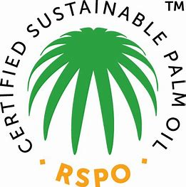
This is RSPO mark which tackles environment protection dealing with the problems of palm oil production.
It proves the companies
don’t cut down nature forests needed to be preserved
eliminate the unjustified work and secure the laborers health and security.
Notes:
RSPO mark also tackles environment protection dealing with the problems of palm oil production. The standard proves the companies with RSPO don’t cut down nature forests needing to be preserved and eliminate the justified work and secure the laborers health and security.

Slide 16
Notes:
This mark is seen in familiar goods like above.

Slide 17
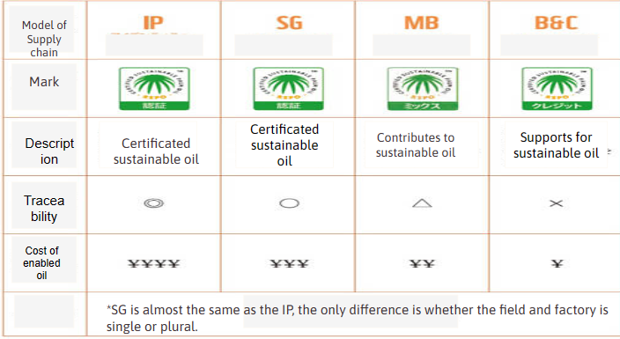
There are 4 types of RSPO marks by contribution for protection of environment.
The more left marks is more effective
Notes:
There are 4 types of RSPO marks considering how the supply chains contribute to sustainability considering the complex supply chains. The most effective mark on preservation is Identity Preserved (ID) which guarantees that the palm oil is divided from other palm oil completely. On the other hand, B&C model shows just monetary supports for this protection activity. Therefore it’s desirable to buy goods with more left model.

Slide 18
Reading
This is a document of some solution to protect nature from the aspect of politics and government
➤Click here and Read the part of “THE TARGETS”

Slide 19
Discussion
Let’s think and discuss about how we can protect our nature…
And write down your idea!!

