Slide 1
What is SDGs

Slide 2
Solution to achieve the goals of SDGs

Slide 4
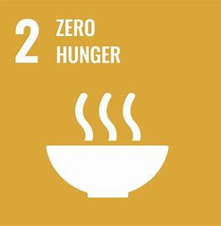

Slide 5
A lot of food wastes in developed countries
Unconscious stereotypes and bias
More energy generating, more pollution will be produced

Slide 6
To achieve sdgs goal,
it costs
$5trillion
per year

Slide 7
Need minimum goal to achieve

Slide 8
Some country refuses SDGs for their culture issues

Slide 9
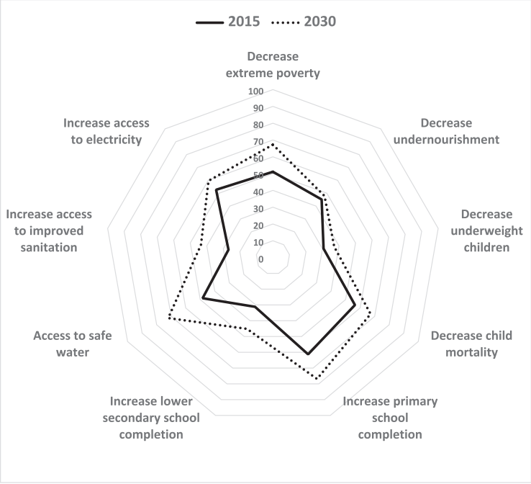

Slide 10
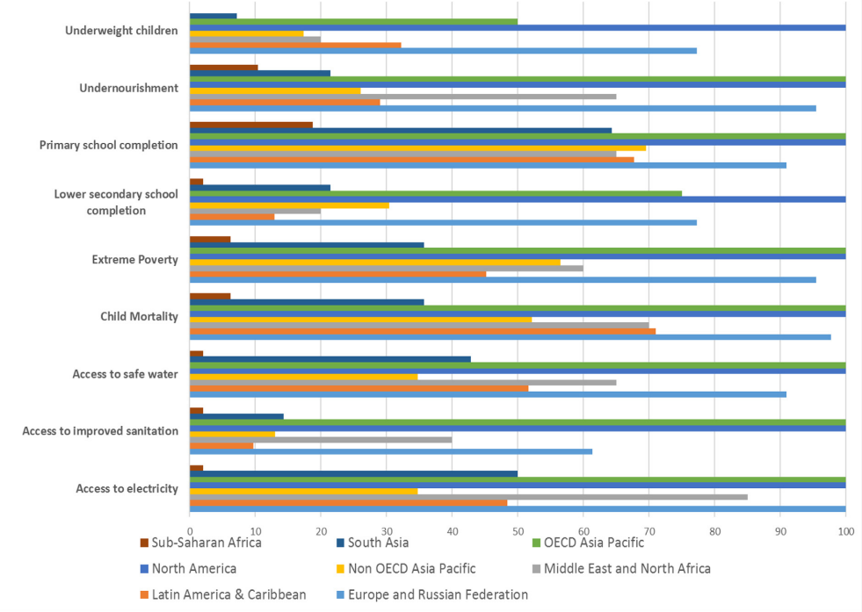

Slide 11
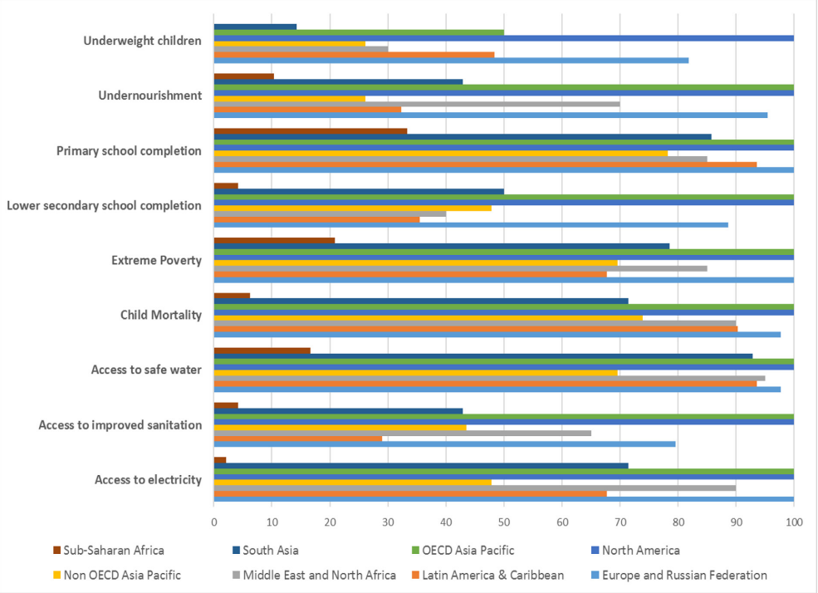

Slide 12
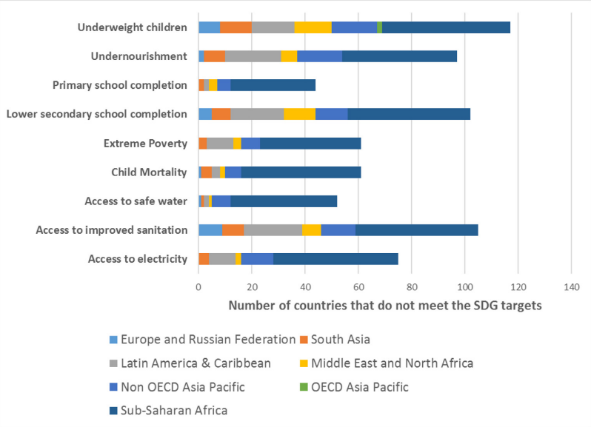

Slide 13
How to Solve

Slide 14
Speaking & Writing
Think solutions of the problem which was discussed in the previous section.
About 10 minutes
You should read two articles as a hint
words colored in yellow are key words

Slide 15
Discussion！About 5 minutes

Slide 16
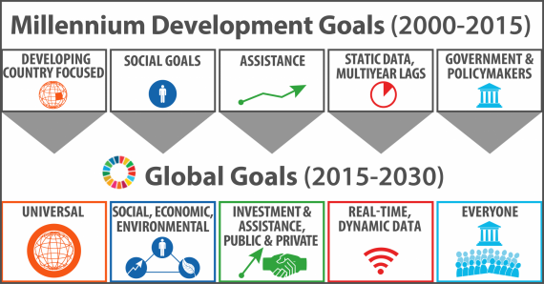
Before SDGs
SDGs2030
MDGs2015

Slide 17
After 2030?

Slide 18
What is the fundamental problem in Indonesia, with regard to children?
How should the SDG limitations be improved? Choose one goal and explain your improvements.
Reading & Writing!

